Slide 1
Virtual Collective Worship WB 22.06.20

Slide 2
Listen to the clip below and sing a long if you know it.
Whilst you listen to it, think about what the song is telling you.
What is the message it is telling us today?
How does it make you feel?

Slide 3
This week our word is TRUST Reflect on what trust means to you. How do we show trust? What does trust look like?

Slide 5
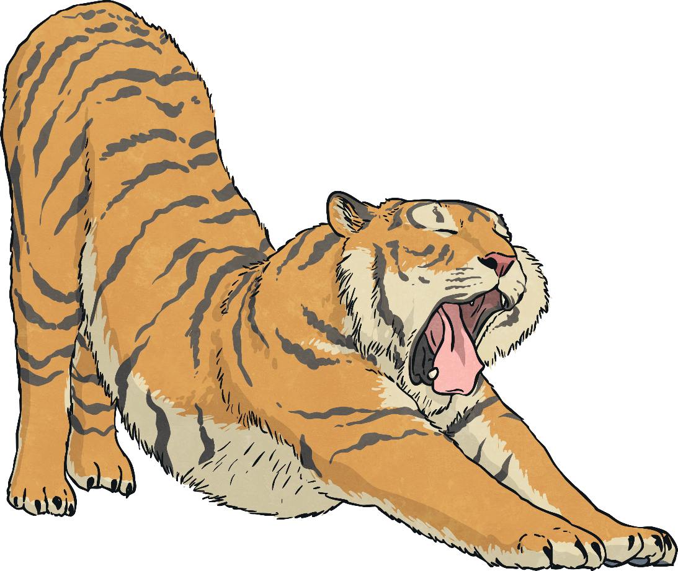
The Tiger’s Whisker
An old Korean folktale about trust.
Once upon a time, in a land far, far away, there lived a husband and wife who were very happy together.
One day, the husband had to go off to sea because he had to go to war. He was away for many months.
When he returned, his wife was so pleased to see him. She ran over and threw her arms around him.
“I have missed you so much!” she cried.
Her husband did not reply.

Slide 6
The Tiger’s Whisker
“Have you missed me?” the woman asked, shaking her husband by the shoulder, as if to wake him up.
Her husband still did not reply.
He remained silent for the rest of the day and then for three days after that.
The wife was very worried and sought help from the wise woman of the village.
The wise woman thought long and hard about the problem, until at last she declared, “I know what needs to be done.”
“What?” cried the wife. “I’ll do anything. I just want my dear old husband back.”
“You must do this,” said the wise woman, “go to the top of the highest mountain and bring me back a whisker from the tiger you will find living in the darkest cave.”

Slide 7
The Tiger’s Whisker
The wife began to shake. “I can’t possibly do that, I’ll die!” she stuttered.
“Where there’s a will, there’s a way,” replied the wise woman, “and you did say you’d do anything.”
“Alright, I’ll do it,” said the wife, resolving to put her fears behind her, and off she went.
She began a steady climb up the highest mountain and trudged along for five hours with barely a break. The midday sun beat down on her, but still she carried on.
At last, she reached the entrance to the cave.
She placed some meat, that she’d brought with her, in front of the cave entrance, then hid behind a rock and waited.
Not long after, the tiger appeared from inside the cave, its whiskers twitching at the smell of the delicious treat that awaited him. He gobbled up the meat and returned to the cave for a nap.

Slide 8
The Tiger’s Whisker
The woman repeated this every day, for three days. On day five, she peered out from behind the rock while the tiger was eating. The tiger lifted his head and stared at her straight in the eyes, then carried on eating.
On day six, the woman stood next to the rock as the tiger ate. Again, the tiger took no notice of her.
On day seven, the woman stood in front of the rock while the tiger ate. He looked at her for a few seconds, then continued eating.
On the eighth day, the woman waited near the cave entrance with the meat in her hand.
The tiger followed the scent of the tasty snack and ate it straight from the woman’s hand! As he was doing so, the woman quickly plucked a whisker from the tiger, who didn’t notice a thing!

Slide 9
The Tiger’s Whisker
“Look! I have the whisker!’’ the wife cried, as she ran into the wise woman’s house.
The wise woman said not a word, but snatched the whisker from the wife’s hand and threw it on the fire!
“What have you done that for? I risked my life getting that! You promised you’d help my husband!” the wife exclaimed.
“You don’t need my help. You got a whisker from a live tiger. You can easily help your husband by applying the same skills,” replied the wise woman.
The wife left the house and walked home, wondering what the wise woman meant. On the way back, she had a revelation.
“Of course! I just need to be patient,” she said.
So she was.
A few weeks later, her husband started talking again and things went back to how they had been before he’d gone away.

Slide 10
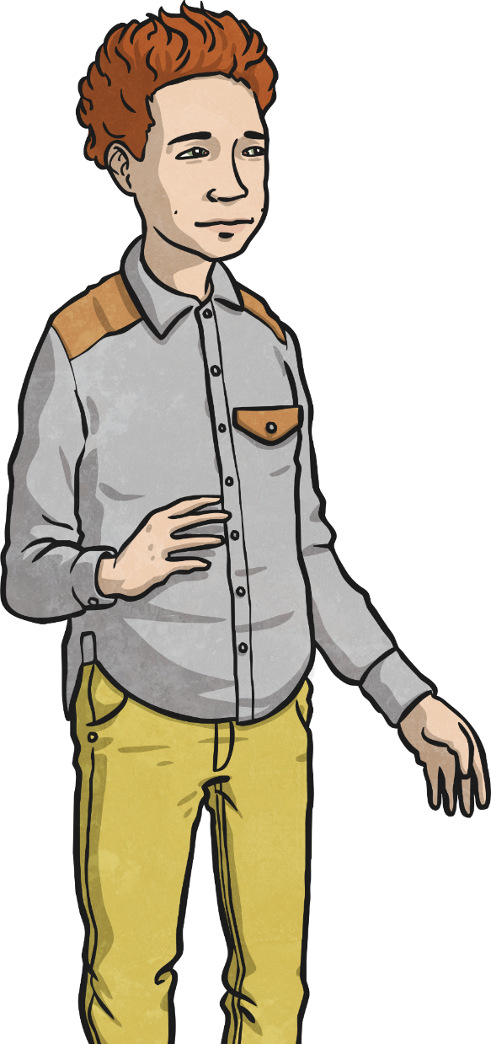
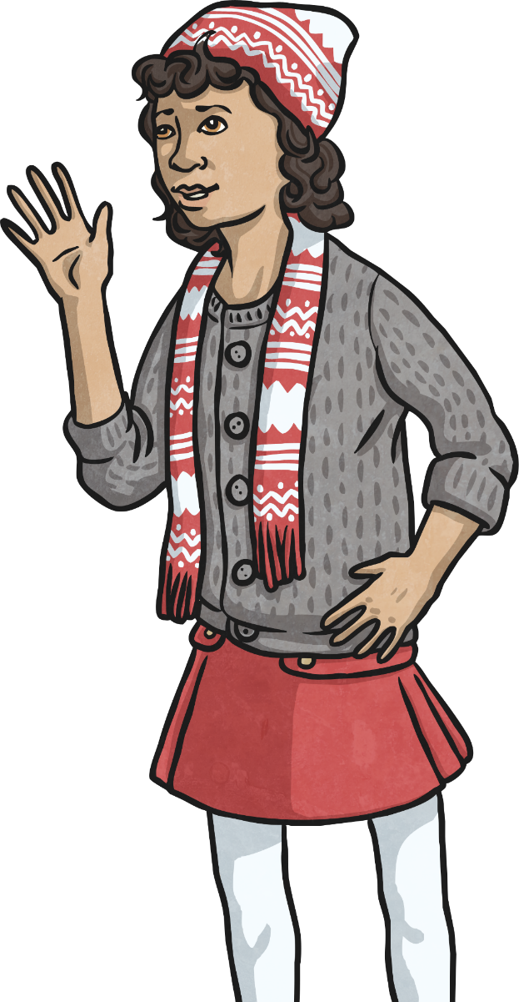
The Tiger’s Whisker teaches us:
that trust has to be earned;
that it may take time to build up trust;
that trust is worth taking time over.
Think about how important trust is in a friendship.
How might a friend show he/she was trustworthy?

Slide 12
Activity: 21 Trust
Materials: None
Players: 2+
With the people that live at home. Sit in a circle, with your backs turned, the whole family are to play the game 21. This activity is about trusting each other and putting the fate of the game in someone else’s hands. Players can all speak whenever they wish, saying one number at a time. They need to count up to 21 collectively. If a child says the same number at the same time as another, you start back at 0.
Reflect after about what was hard about trusting friends during that activity. Why was it hard? What would make it easier to trust next time? Discuss how we usually find it easier to trust people who we know well, which is ok. Usually we wouldn’t need to trust lots of people at the same time.

Slide 14
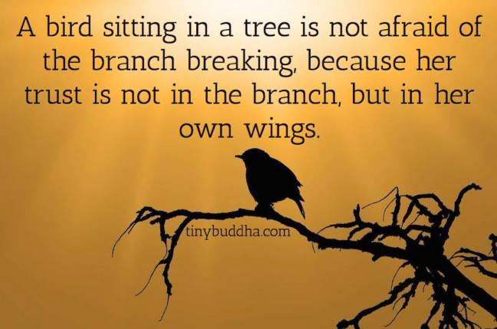

Slide 15
Reflection
Trust is an important part of relationships. You cannot build a relationship without trust.
Listen to each other and show them you care.
Observe other people by paying attention to their interests.
Think about how you can show them your love and trust.
Reflect on how you could’ve said or acted differently to help build trust.
Who are you going to build on trust with this week? Who will you show your trust to? Can you keep a promise to show you’re trustworthy?

Slide 16
